Slide 1

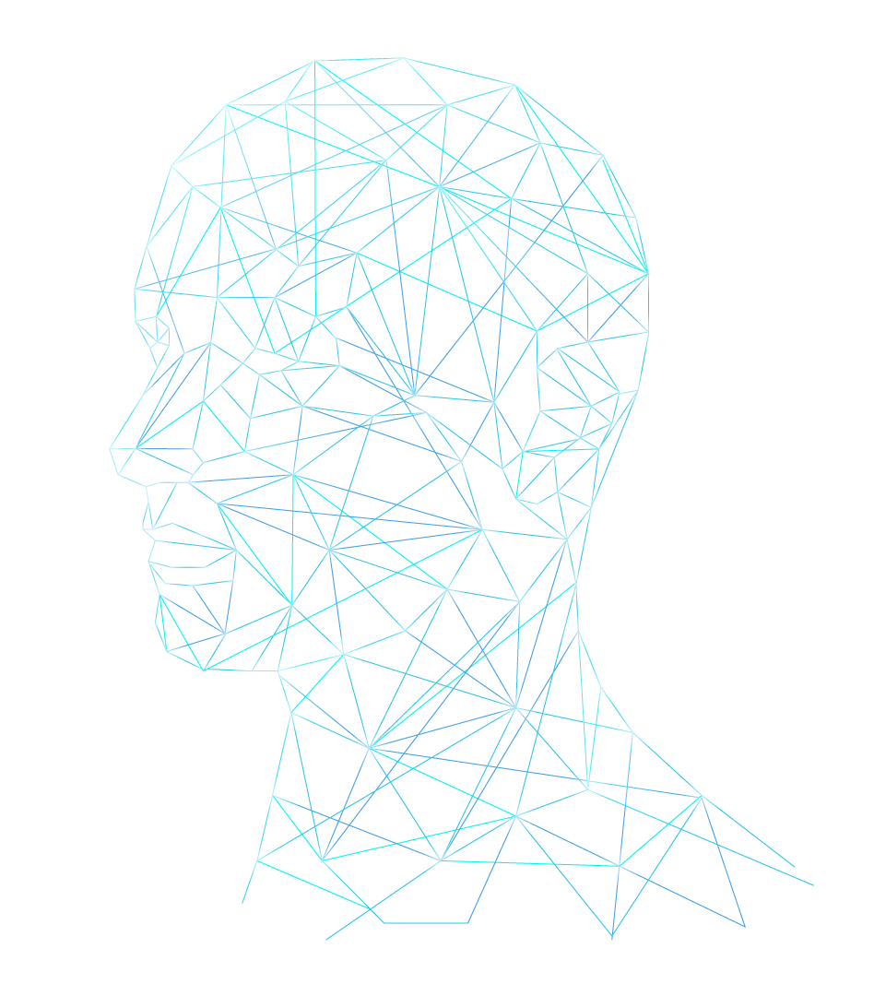
AGENT ALPHA

Slide 2

Team: Agent Alpha
Title: Background Image and Music Remover Using AI
Tagline: Clean Visuals, Clear Sounds

Slide 3
Team Members
Beesabathuni Tejaswi
Vintha Poojitha
Dantla Akshitha
Mekala Swathi Sri
Branch: CSE, VFSTR
Due Date: 27th May 2025

Slide 4
Idea Overview
Category: ai, multimedia, automation
Summary: ai-powered agent that removes background images/music from media while preserving quality. Supports custom background replacement.

Slide 5
Problem Statement
Manual editing is time-consuming and complex.
Target Users: Content creators, educators, influencers.
Goal: Make professional-quality editing accessible.

Slide 6
Proposed Solution
- Image/Video: U-2-Net, MODNet
- Audio: Demucs, Spleeter
Multi-format support
Workflow:
1. Upload
2. Process
3. Replace (optional)
4. Download

Slide 7
Technologies Used
- Python, TensorFlow/PyTorch
- FFmpeg
- React/Flask
- AWS/GCP
- Pre-trained AI models

Slide 8
Uniqueness & Innovation
Automated, unified editor for audio/image/video
Real-time preview
Cross-media processing
Custom replacement options

Slide 9
Feasibility & Implementation
Technically feasible with available models.
Resources: Python, cloud, AI expertise
Timeline:
Week 1–6: Dev to demo video

Slide 10
Impact & Market
Market: Creators, educators, agencies
Impact:
- Social: Accessible editing
- Economic: Cost/time saving
- Tech: Creative AI use

Slide 11
Prototype
GitHub (placeholder):
https://github.com/yourusername/background-remover

Slide 12
Future Scope
- Real-time webcam/audio editing
- Mobile app
- Language/emotion detection
- Platform integration

Slide 13
Additional Info
Includes authentication, encryption, and batch support
Premium features possible
Scalable architecture

Slide 14
AI TECH AGENCY INFOGRAPHICS
STEPS
MARS
Earth is the third planet from the Sun
JUPITER
Despite being red, Mars is very cold
EARTH
Jupiter was named after a Roman god

Slide 15
AI TECH AGENCY INFOGRAPHICS
PHASES
VENUS
01
Venus is the second planet from the Sun
MARS
02
Despite being red, Mars is actually a cold place
JUPITER
03
Jupiter is the biggest planet of them all

Slide 16
AI TECH AGENCY INFOGRAPHICS
SERVICES
JUPITER
01
Jupiter is the biggest planet in the Solar System
02
NEPTUNE
Neptune is the farthest planet from the Sun
VENUS
03
Venus is the second planet from the Sun
04
MARS
Despite being red, Mars is actually a cold place
MERCURY
05
Mercury is the closest planet to the Sun

Slide 17
AI TECH AGENCY INFOGRAPHICS
LAST TECHNOLOGIES
EARTH
SATURN
Earth is the third planet from the Sun
Saturn is not the only planet with rings
AI
Jupiter is a gas giant and the biggest planet in the Solar System. It's the fourth-brightest object in the night sky
MARS
NEPTUNE
Despite being red, Mars is actually a cold place
Neptune is the farthest planet from the Sun

Slide 18
AI TECH AGENCY INFOGRAPHICS
CONNECTIVITY
NEPTUNE
01
Neptune is the farthest planet from the Sun
02
03
SATURN
JUPITER
Saturn is not the only planet with rings
Jupiter is the biggest planet of them all

Slide 19
AI TECH AGENCY INFOGRAPHICS
INTERNET CONSUMPTION
NEPTUNE
MERCURY
10%
25%
Neptune is the farthest planet from the Sun
Mercury is the closest planet to the Sun
VENUS
JUPITER
50%
75%
Venus is the second planet from the Sun
Jupiter is the biggest planet of them all

Slide 20
AI TECH AGENCY INFOGRAPHICS
MERCURY
EARTH
Mercury is the closest planet to the Sun
Earth is the third planet from the Sun
TYPES OF AIs
MARS
SATURN
Despite being red, Mars is very cold
Saturn was named after a Roman god

Slide 21
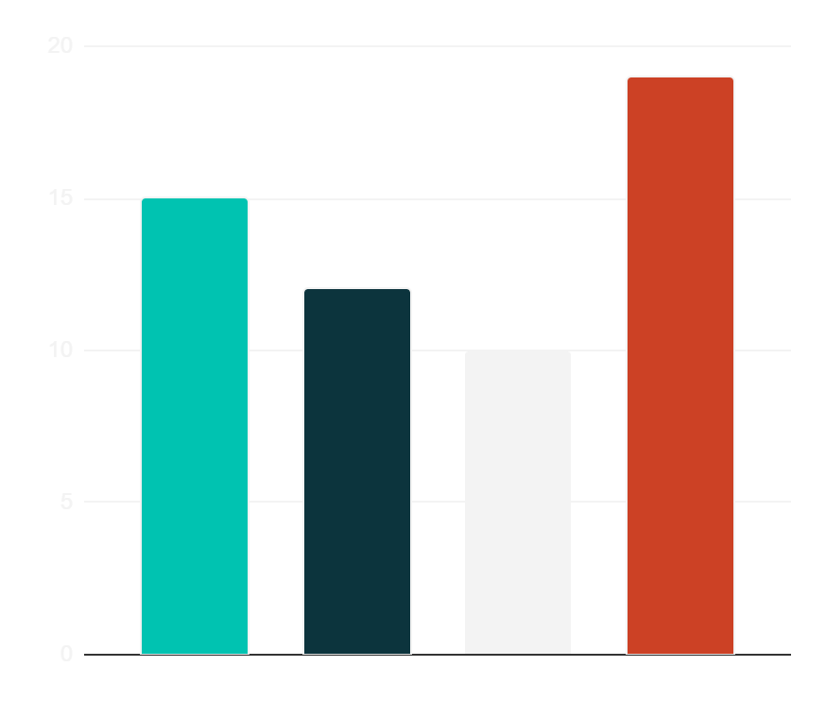
AI TECH AGENCY INFOGRAPHICS
OUR SCHEDULE
12h
JUPITER
Jupiter is a very big planet
19h
VENUS
Venus has a toxic atmosphere
15h
MARS
Mars was named after a god
Jupiter
Venus
Mars
Mercury
10h
MERCURY
Follow the link in the graph to modify its data and then paste the new one here. For more info, click here
Mercury is a small planet

Slide 22
AI TECH AGENCY INFOGRAPHICS
HOW WE PROCERE
CHANNELS
BUDGET
25,000,000
Multimedia
DESCRIPTION
GOALS
Saturn is a gas giant and has several rings. It's composed mostly of hydrogen and helium. It was named after the Roman god of wealth and agriculture
You can list your goals here
You can list your goals here
You can list your goals here
You can list your goals here

Slide 23
AI TECH AGENCY INFOGRAPHICS
STRATEGY
01
02
03
VENUS
SATURN
EARTH
Venus is the second planet from the Sun
Saturn is a gas giant with rings
Earth is the third planet from the Sun

Slide 24
AI TECH AGENCY INFOGRAPHICS
OUR VALUES
40% | 60%
MISSION | VISION
Mercury is the closest planet to the Sun and the smallest one in the Solar System | Venus has a beautiful name and is the second planet from the Sun

Slide 25
AI TECH AGENCY INFOGRAPHICS
SOLUTIONS
Mercury is the closest planet to the Sun and the smallest of them all
MERCURY
MARS
Despite being red, Mars is actually a cold place
Venus has a beautiful name and is the second planet from the Sun
VENUS

Slide 26
AI TECH AGENCY INFOGRAPHICS
PLANNING
 | MON | TUE | WED | THU | FRI
08:00 | Insert your own text | Insert your own text | Insert your own text | Insert your own text | Insert your own text
10:00 | Insert your own text | Insert your own text | Insert your own text | Insert your own text | Insert your own text
12:00 | Insert your own text | Insert your own text | Insert your own text | Insert your own text | Insert your own text
2:00 | Insert your own text | Insert your own text | Insert your own text | Insert your own text | Insert your own text

Slide 27
AI TECH AGENCY INFOGRAPHICS
NEXT EVENTS
1
Venus is the second planet from the Sun
Earth is the third planet from the Sun
1ST EVENT
4
2
2ND EVENT
4TH EVENT
3RD EVENT
Saturn is a gas giant with rings
3
Jupiter doesn’t have a solid surface

Slide 28
AI TECH AGENCY INFOGRAPHICS
SOME PORCENTAGES
30%
MARS
Despite being red, Mars is actually a cold place
50%
JUPITER
Jupiter is the biggest planet in the Solar System
25%
SATURN
Saturn is the second-largest planet in the Solar System
75%
NEPTUNE
Neptune is the fourth-largest planet in the Solar System

Slide 29
AI TECH AGENCY INFOGRAPHICS
STAGES
VENUS
EARTH
Venus is the second planet from the Sun
Earth is the third planet from the Sun
MERCURY
MARS
Mercury is the closest planet to the Sun
Despite being red, Mars is very cold
40%
10%
20%
30%

Slide 30
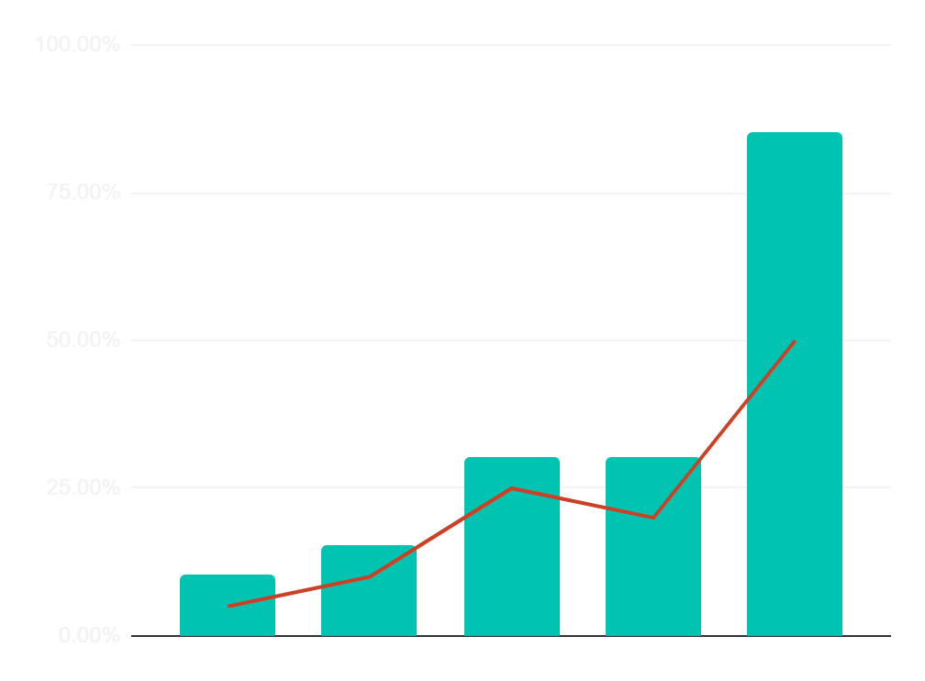
AI TECH AGENCY INFOGRAPHICS
PREDICTED RESULTS
$30,000
Expected income for 20XX
300
New employees next year
Jan
Feb
Mar
Apr
Jun
Follow the link in the graph to modify its data and then paste the new one here. For more info, click here

Slide 31
AI TECH AGENCY INFOGRAPHICS
TASKS PER MONTH
 | 1 | 2 | 3 | 4
TASK 1
TASK 2
TASK 3
Mercury is a very small planet
Venus is very hot
Mars is cold

Slide 32
AI TECH AGENCY INFOGRAPHICS
NUMBERS
MERCURY
VENUS
MARS
JUPITER
Mercury is the closest planet to the Sun
Venus is the second planet from the Sun
Despite being red, Mars is very cold
Jupiter is the biggest planet of them all
10%
40%
30%
20%

Slide 33
Instructions for use
If you have a free account, in order to use this template, you must credit Slidesgo in your final presentation. Please refer to the next slide to read the instructions for premium users.
As a Free user, you are allowed to:
- Modify this template.
- Use it for both personal and commercial projects.
You are not allowed to:
- Sublicense, sell or rent any of Slidesgo Content (or a modified version of Slidesgo Content).
- Distribute Slidesgo Content unless it has been expressly authorized by Slidesgo.
- Include Slidesgo Content in an online or offline database or file.
- Offer Slidesgo templates (or modified versions of Slidesgo templates) for download.
- Acquire the copyright of Slidesgo Content.
For more information about editing slides, please read our FAQs or visit our blog:
https://slidesgo.com/faqs and https://slidesgo.com/slidesgo-school

Slide 34
Instructions for use (premium users)
As a Premium user, you can use this template without attributing Slidesgo.
You are allowed to:
Modify this template.
Use it for both personal and commercial purposes.
Share this template in an editable format with people who are not part of your team.
You are not allowed to:
Sublicense, sell or rent this Slidesgo Template (or a modified version of this Slidesgo Template).
Distribute this Slidesgo Template (or a modified version of this Slidesgo Template) or include it in a database or in any other product or service that offers downloadable images, icons or presentations that may be subject to distribution or resale.
Use any of the elements that are part of this Slidesgo Template in an isolated and separated way from this Template.
Register any of the elements that are part of this template as a trademark or logo, or register it as a work in an intellectual property registry or similar.
For more information about editing slides, please read our FAQs or visit our blog:
https://slidesgo.com/faqs and https://slidesgo.com/slidesgo-school

Slide 35
Infographics
You can add and edit some infographics to your presentation to present your data in a visual way.
Choose your favourite infographic and insert it in your presentation using Ctrl C + Ctrl V or Cmd C + Cmd V in Mac.
Select one of the parts and ungroup it by right-clicking and choosing “Ungroup”.
Change the color by clicking on the paint bucket.
Then resize the element by clicking and dragging one of the square-shaped points of its bounding box (the cursor should look like a double-headed arrow). Remember to hold Shift while dragging to keep the proportions.
Group the elements again by selecting them, right-clicking and choosing “Group”.
Repeat the steps above with the other parts and when you’re done editing, copy the end result and paste it into your presentation.
Remember to choose the “Keep source formatting” option so that it keeps the design. For more info, please visit our blog.

